Slide 1

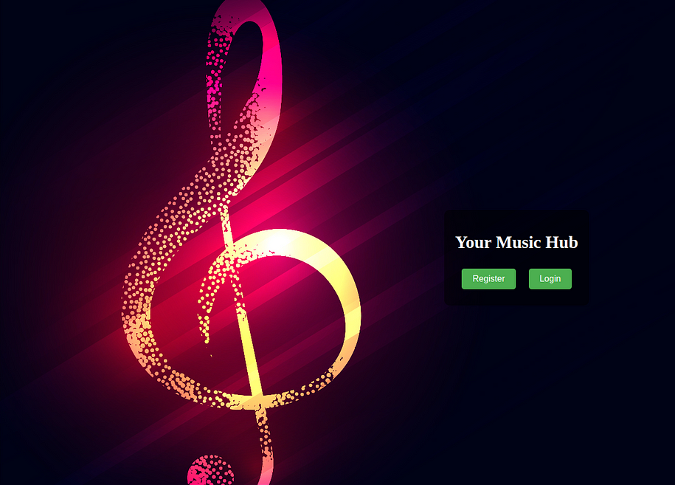
Django-based Music Web Application!
Harmony at Your Fingertips: Where Music Meets Convenience
Student Name :
AMIT BHARDWAJ
College Name :
Student ID :
Institute of technology Guru Ghasidas Bilaspur C.G.
STU6516fceb6c6661696005355

Slide 2
Harmony at Your Fingertips: Where Music Meets Convenience
PROJECT SHOWCASE
Project Title
Django-based Music Web Application!
Signup, Login, Home, All Songs, History, Watch Later, and Django Admin functionalities.

Slide 3
Harmony at Your Fingertips: Where Music Meets Convenience
Seamless Registration Process
1
Description of the Signup page.
2
User-friendly interface for easy registration.
3
Steps for users to create their accounts and access the full functionality of the platform.

Slide 4
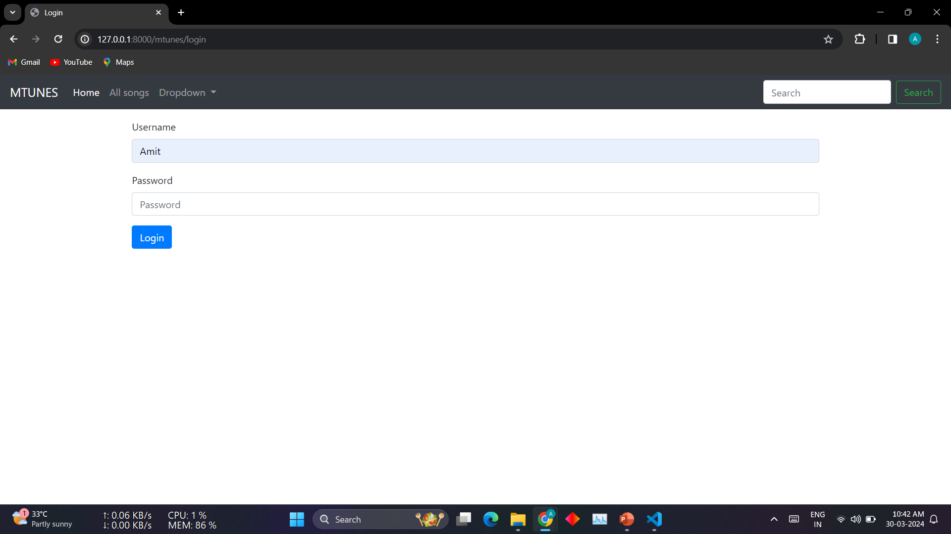
Harmony at Your Fingertips: Where Music Meets Convenience
Secure Access to Your Music
Description of the Login page.
Highlighting the importance of secure login procedures.
Emphasizing user authentication for personalized experiences.

Slide 5
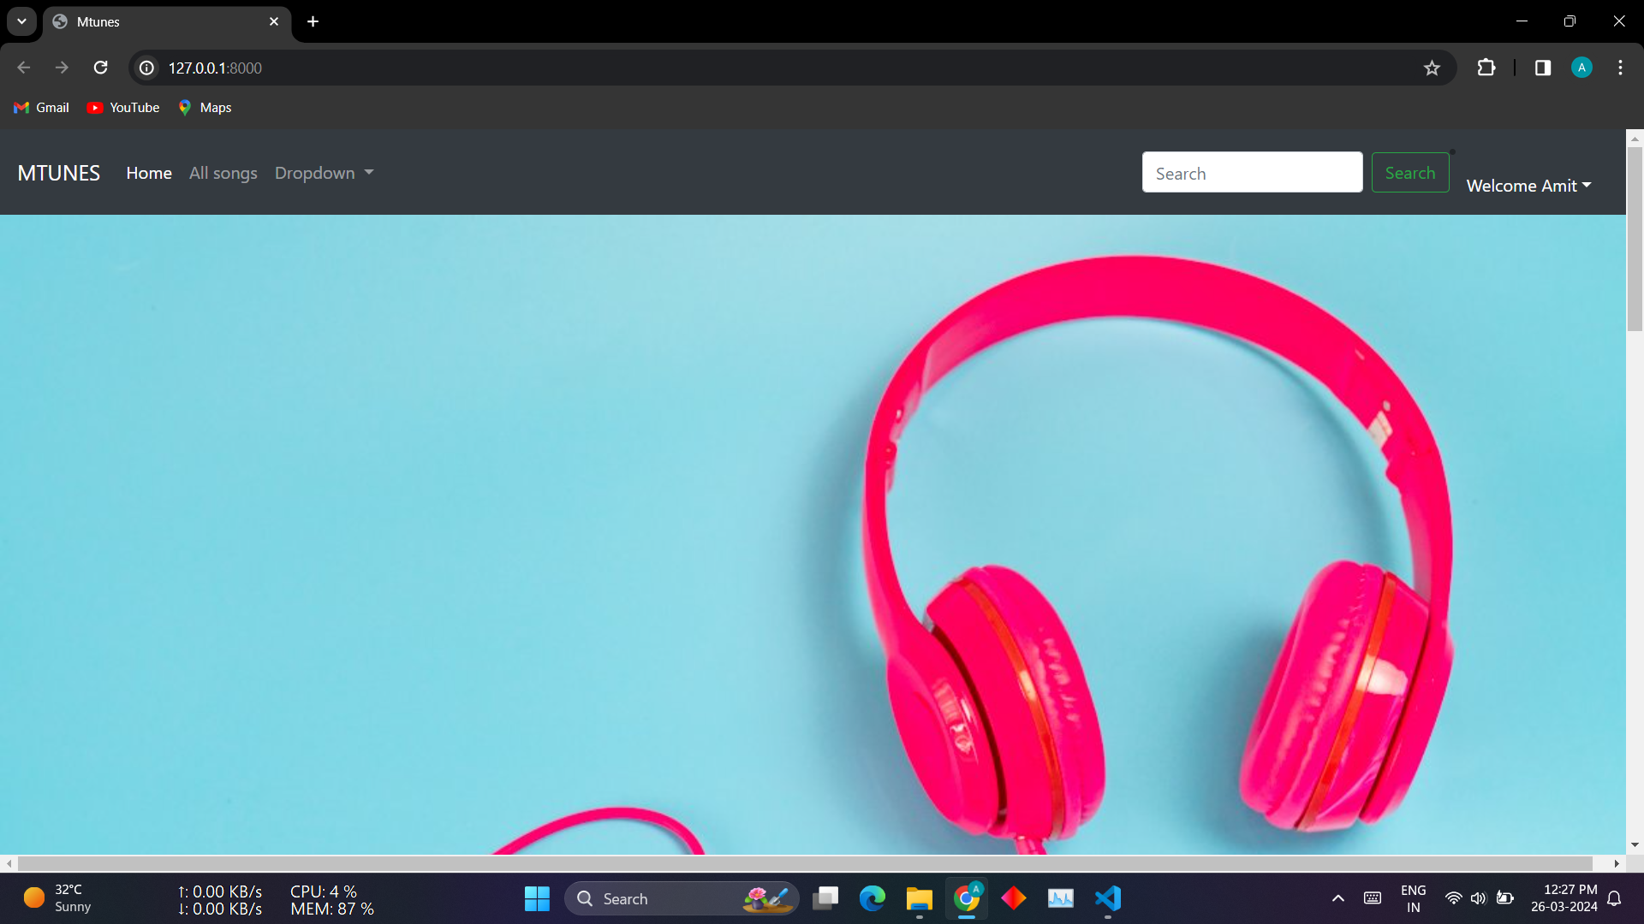
Harmony at Your Fingertips: Where Music Meets Convenience
Your Gateway to Music Exploration
Overview of the Home page.
Central hub for users to navigate through various sections.
Features personalized recommendations and trending songs.

Slide 6
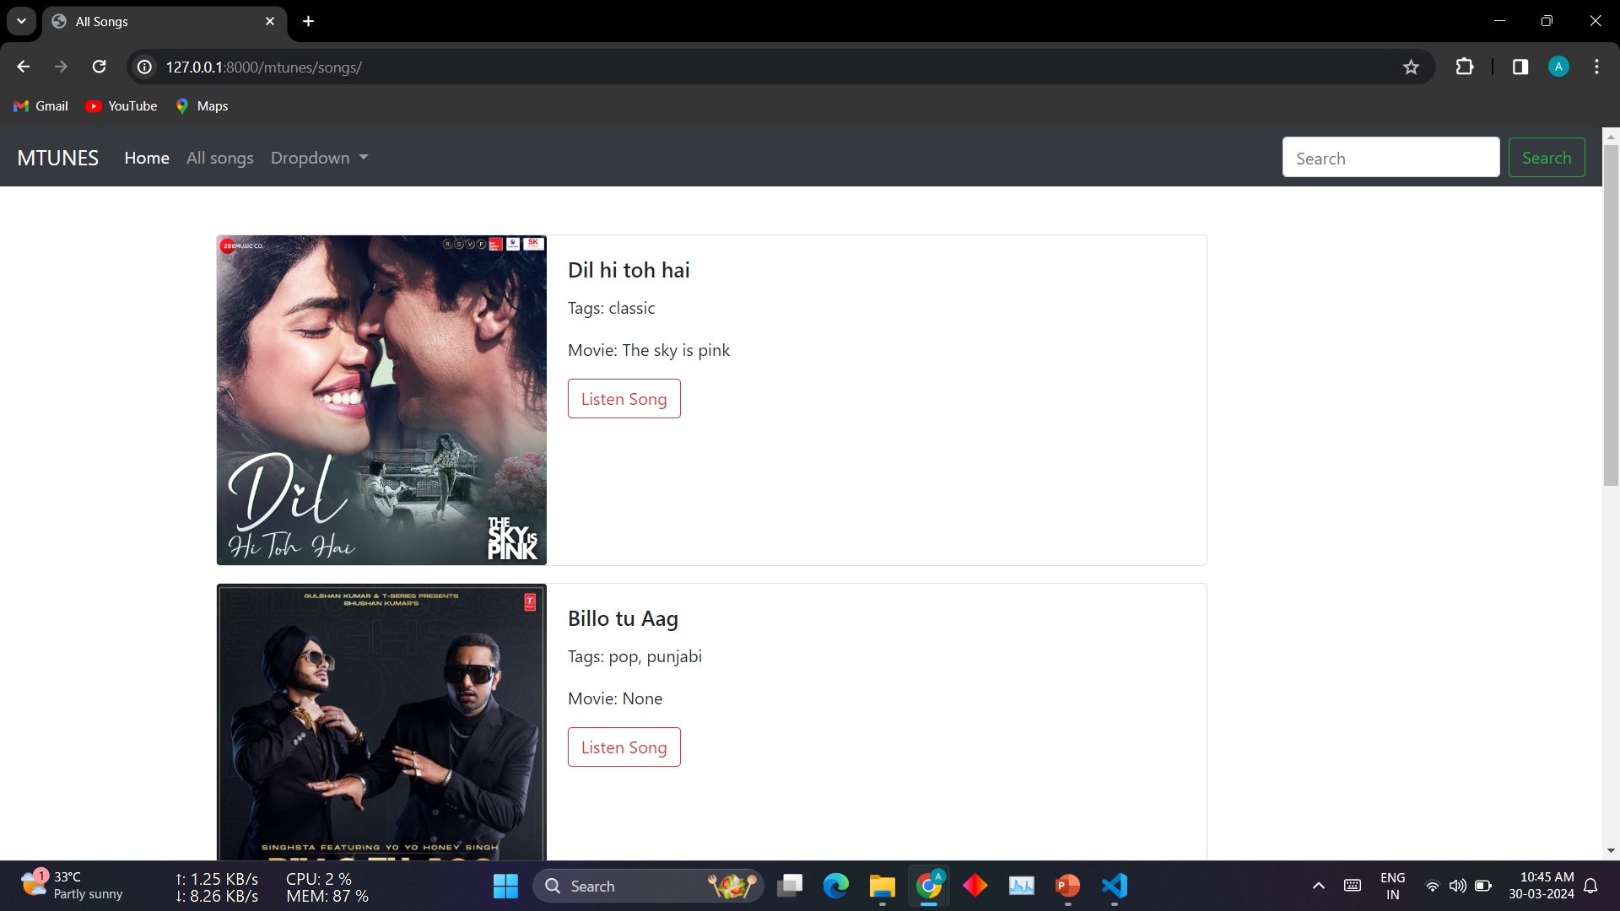
Harmony at Your Fingertips: Where Music Meets Convenience
Explore the Melodic Universe
Introduction to the All Songs page.
Vast library of songs categorized for easy browsing.
Options to search, filter, and discover new music based on preferences.

Slide 7
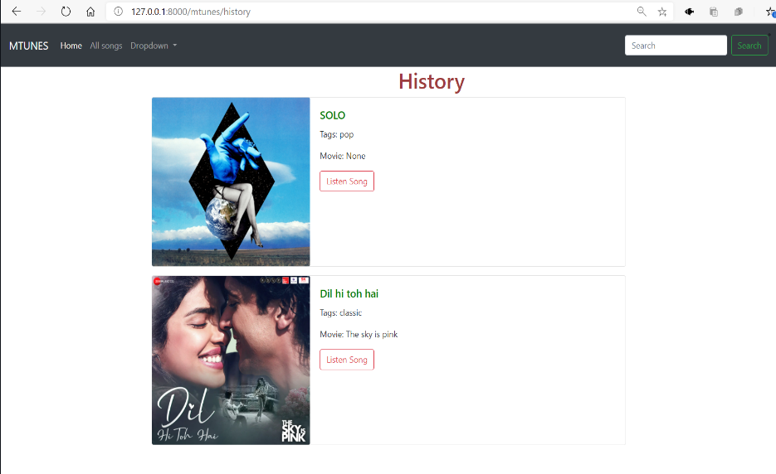
Harmony at Your Fingertips: Where Music Meets Convenience
Relive Your Musical Journey
Description of the History page.
Tracks user's listening history for convenient playback.
Enables users to revisit favorite songs and explore their musical journey.

Slide 8
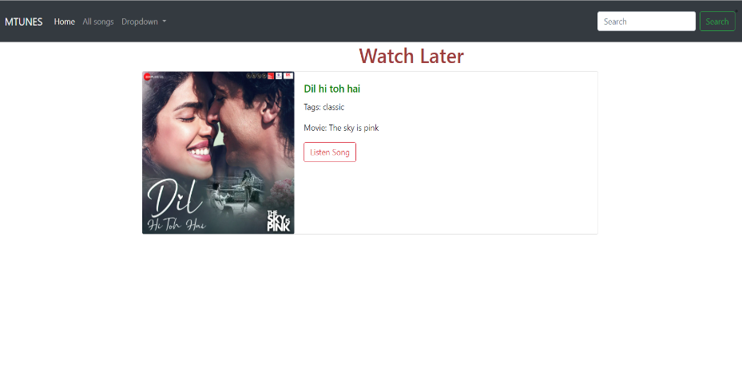
Harmony at Your Fingertips: Where Music Meets Convenience
Curate Your Playlist for Later Enjoyment
Overview of the Watch Later page.
Allows users to bookmark songs for future listening.
Feature to create personalized playlists for convenient access.

Slide 9
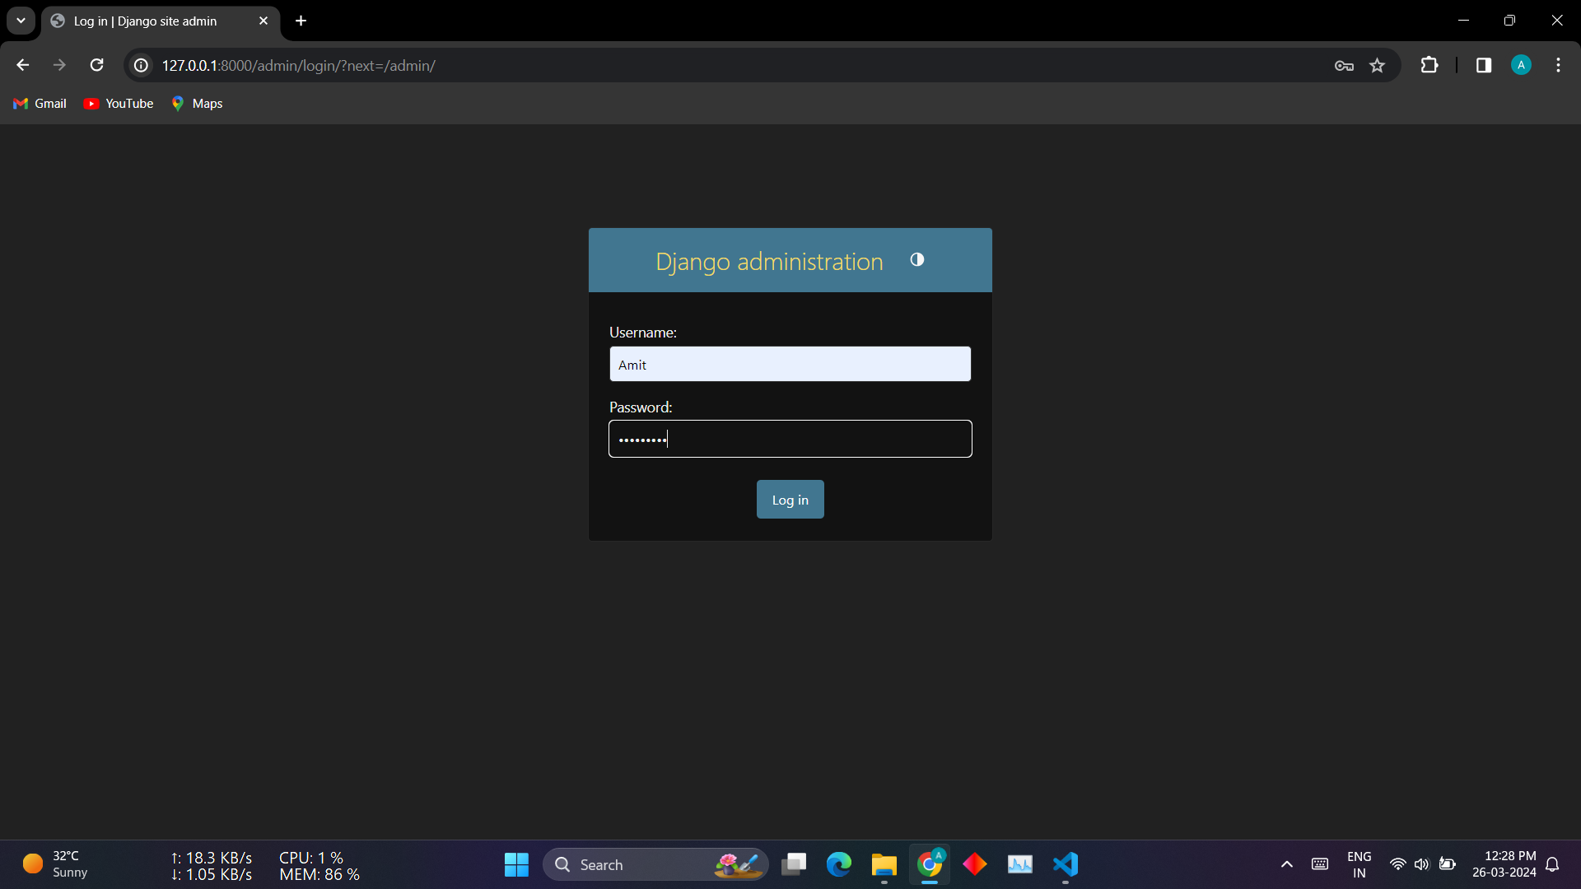
Harmony at Your Fingertips: Where Music Meets Convenience
Admin Access for Streamlined Management
Introduction to the Django Admin Sign-in.
Exclusive access for administrators to manage the backend.
Ensures security and control over the database and site functionality.

Slide 10
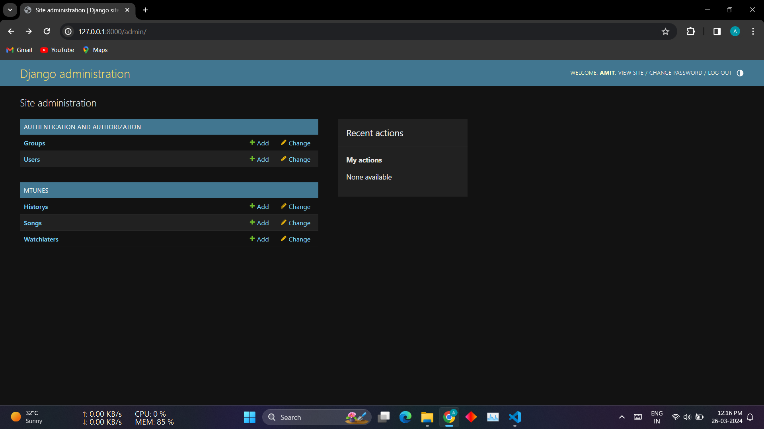
Harmony at Your Fingertips: Where Music Meets Convenience
Centralized Control Hub
Description of the Django Admin Home Page.
Dashboard providing insights and control over various aspects.
Features to manage users, songs, playlists, and site settings.

Slide 11
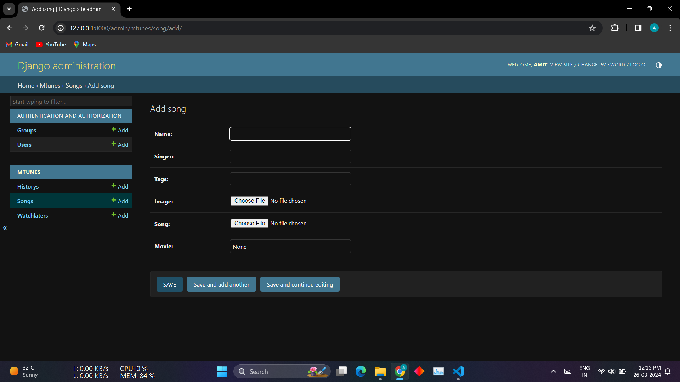
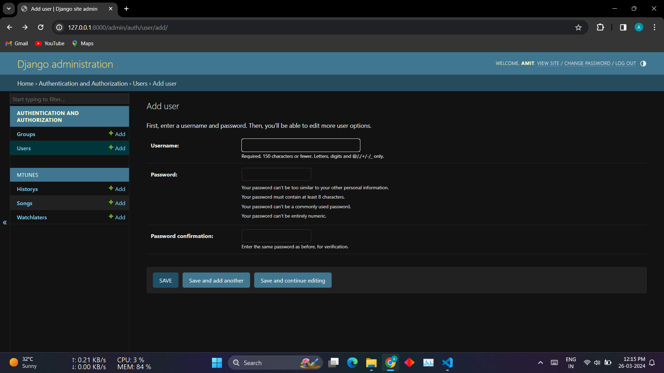
Harmony at Your Fingertips: Where Music Meets Convenience
Data Insights for Informed Decisions
Overview of the Django Admin Dataset.
Comprehensive data on the total number of songs in the database.
Enables administrators to analyze trends, track growth, and make informed decisions for the platform's development and content expansion.

Slide 12


Notes:
Thank You !!

